Slide 1



eHarmony Survey
2021

Slide 2
Understanding dating experiences of single mums

Slide 3

OUR APPROACH
We asked the Mumsnet audience about their experiences of dating as a single parent
We conducted an online survey of women who had dated as a single mum in the last 5 years, were currently dating as a single mum, or considering dating as a single mum.
We asked respondents about their experiences of dating as a single parent, including the barriers they face.
Overall, we collected 1,001 responses.
All data in this report is unweighted

Slide 4
EXECUTIVE SUMMARY
The main obstacle to dating for single mothers is finding the time to do so (87%), whether that’s made up of struggling to find the time to attempt find a potential partner (57%), or not having the time to commit to looking after children as well as going on dates (52%).
Single mums believe that single mothers have a harder time dating than single fathers (87%), with over two thirds (67%) saying that they feel them being a single mum has put potential partners off in the past.
Single mums are more likely to experience negativity on dating apps and websites if they are under 35, with 40% of this cohort indicating that they have experienced matches being negative when they discover they have children. 36% of this group report being typecast as a single mum rather than an individual by potential partners.

Slide 5

BARRIERS TO DATING

Slide 6
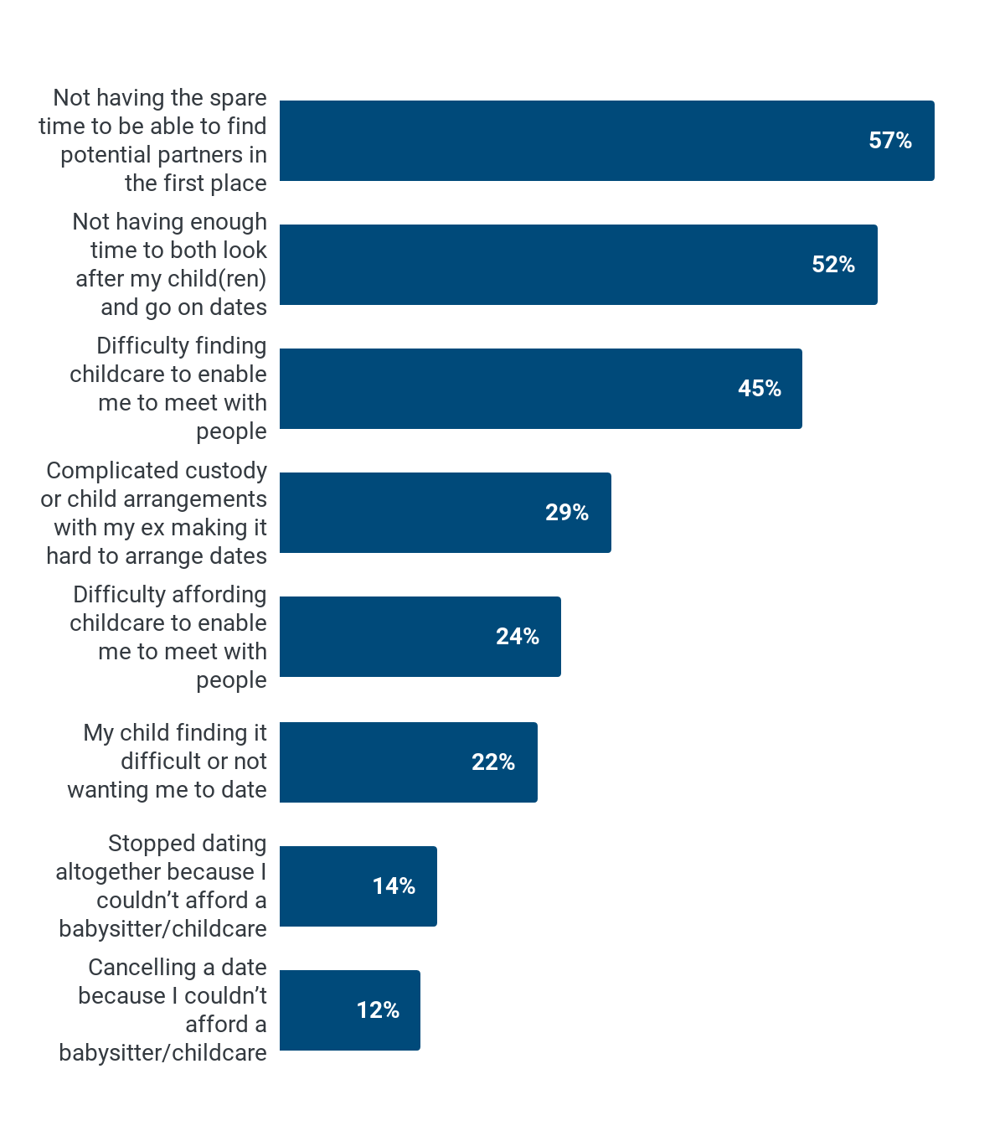
DIFFICULTIES WHILE DATING
87% agree that the main obstacle to dating as a single mum is the amount of available time they have, and not having the time available to date as a single parent was the most common past issue mentioned, with 57% saying that they don’t have the spare time to find a potential partner and 52% saying that they don’t have enough time to look after their children and commit to going on dates.
With 2 in 5 saying that they would like to see a new partner 2 or 3 times a week and a further 2 in 5 saying that they would like to see a new partner weekly, dating is a time consuming process for parents, particularly in stages before they’re willing to introduce a new partner to their children.
Q: Which, if any, of the following have you experienced when dating as a single parent?

Slide 7
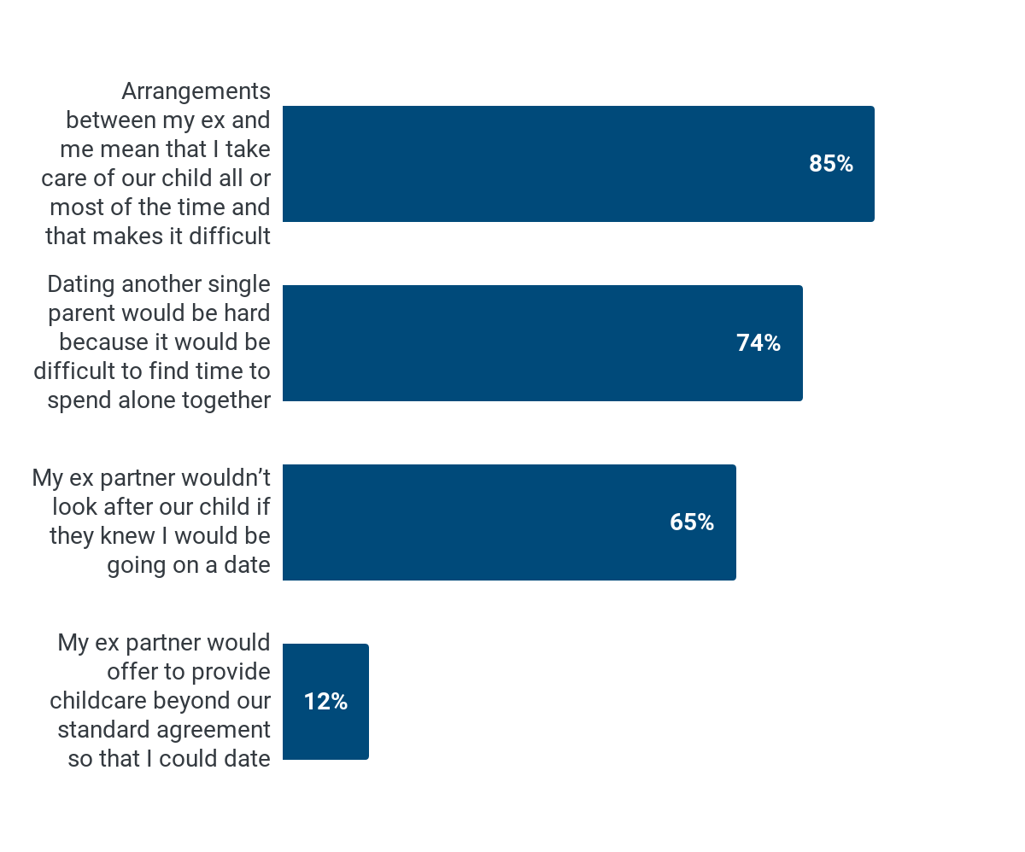
CHILDCARE ARRANGEMENTS AND DATING
Over eight in 10 agree that their childcare arrangements make it difficult to date. This was also the case for three quarters (74%) of those who share custody with their ex partner.
Fewer than one in five (17%) of those who share custody said that their ex partner would offer to provide childcare beyond their custody or child arrangements so that they could date. Over half of those who share custody (53%) suggested that their ex partner wouldn’t look after their child if they knew about a date.
Q: To what extent do you agree or disagree with each of the following statements? Dating showing those who agree with each statement

Slide 8

BARRIERS TO DATING
Well there is a difference between a single parent who shares custody and has every other weekend off, and one who has their child 100% of the time. In that latter situation, dating is hard.
Mumsnet user

Slide 9
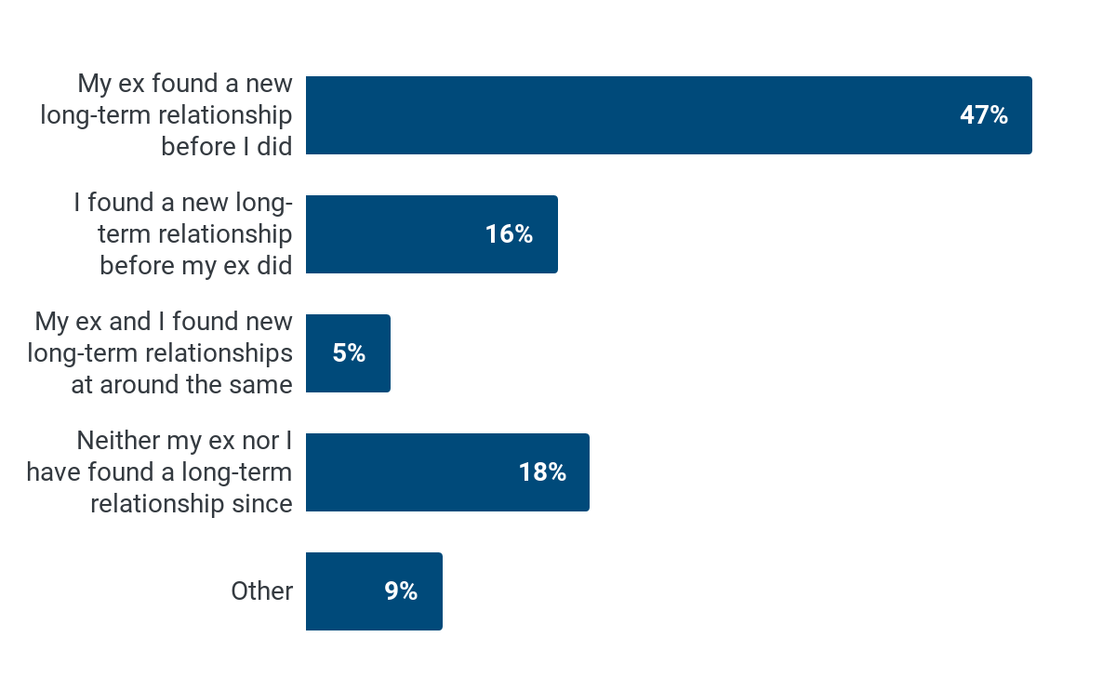
FINDING A NEW RELATIONSHIP
On balance, single mums were more likely to say that their ex partner found a new relationship first (47%) than to say that they found a new relationship before their ex (16%). With a majority of respondents having sole custody or considered the resident parent, many suggested that this was because their ex partner had more available time to commit to dating.
The picture was broadly even for those with a 50:50 custody arrangement, where 33% indicating their ex found a new partner first and 35% saying they did.
My priority is with my children and with every other weekend and one night every fortnight available, it’s very hard to date consistently. Whereas my ex husband has 80% more free time to do as he pleases
Q: Since your relationship with your child’s other parent ended, which of the following is closest to true for you? Please consider relationships that lasted more than three months when responding

Slide 10
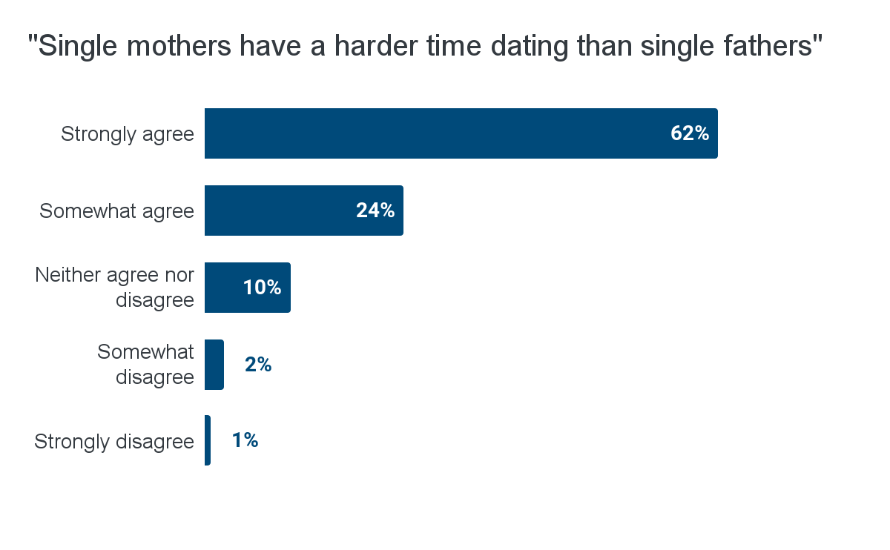
DATING AS A SINGLE MOTHER
There was an overall sentiment that dating for single mothers is harder than for single fathers, with more than three in five strongly agreeing that this is the case, and 87% agreeing overall.
Q: To what extent do you agree or disagree with the following statements? “Single mothers have a harder time dating than single fathers”

Slide 11
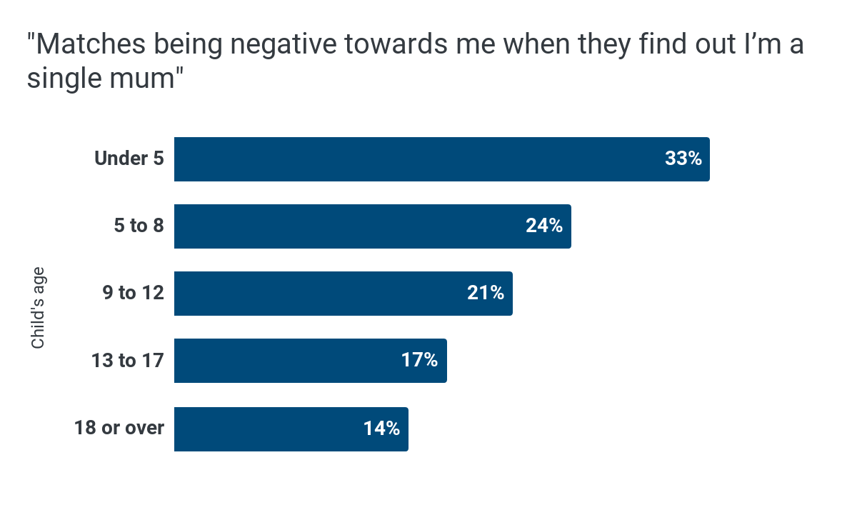
ATTITUDES TO SINGLE MOTHERS
Around one fifth (21%) of those who had used dating apps as a single parent reported experiencing matches being negative when discovering that they’re a single mum.
This negativity was experienced by 33% of those with a child under 5, and 40% of those aged under 35.
Those under 35 are also more likely to report being typecast as a single mum rather than an individual by potential partners (36% vs 15% for those over 35).
Q: Which, if any, of the following issues have you encountered when using online dating platforms? Please tick all that apply.

Slide 12
DATING WITH CHILDREN

Slide 13
DATING WITH CHILDREN
Now I’ve met someone there is a huge dynamic to manage with introducing my kids
Mumsnet user

Slide 14
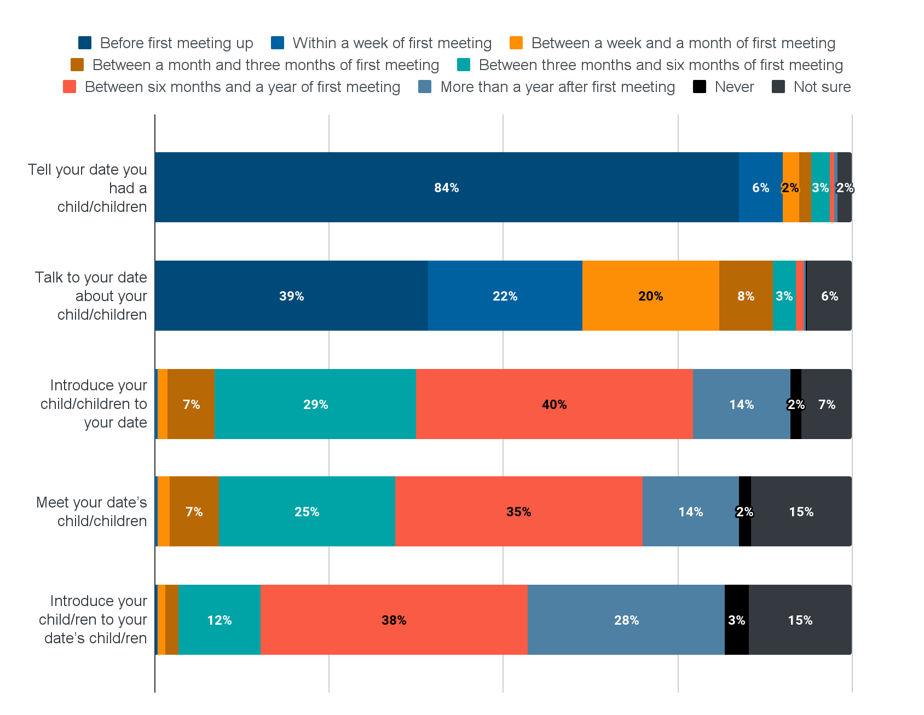
STEPS WHEN DATING WITH CHILDREN
While most single mums indicated that they would mention that they have children early on (usually before first meeting), many indicated that they would be more reluctant to talk about their children with a date or new partner.
Hesitancy transferred to a new partner meeting children for many, with between six and 12 months being the most commonly selected time frame for introducing children to a new partner (40%).
2% suggested that they would never plan to introduce their children to a new partner and 14% said that they would want this to be after a year or more.
Q: Please consider that you're dating someone new. At which point would you plan to take each of the following steps?

Slide 15
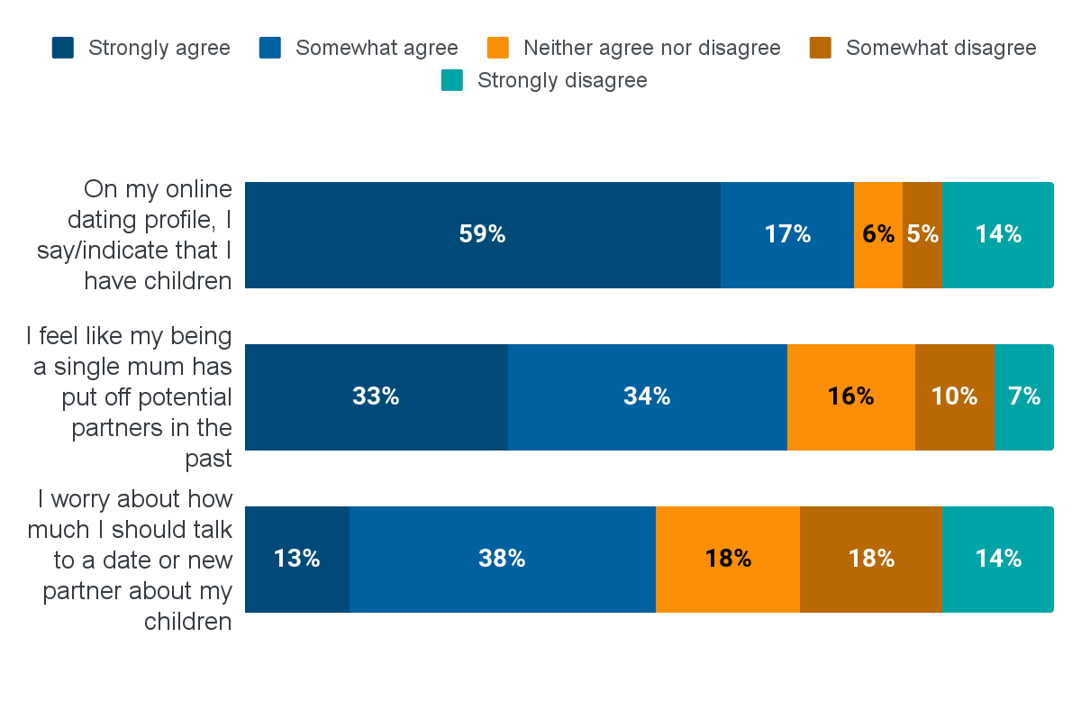
SPEAKING ABOUT CHILDREN WHEN DATING
Three quarters (75%) of those with online dating profiles say that they mention they have children on their profile. Some say that this is because they don’t want to waste time speaking to potential partners who would be put off when they discover they have children: something two thirds (67%) of respondents say they feel has happened to them.
Half (51%) of respondents said that they worry about how much they should talk about their children to a date or a new partner.
Q: Thinking about dating and relationships, to what extent do you agree or disagree with each of the following statements?

Slide 16
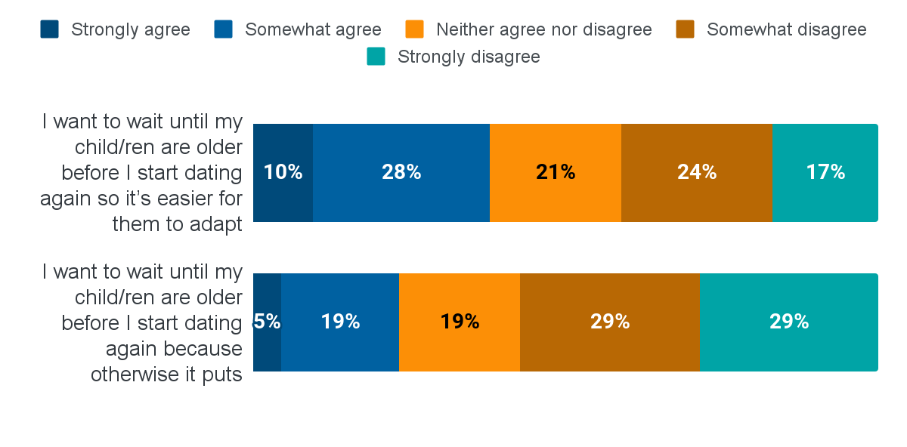
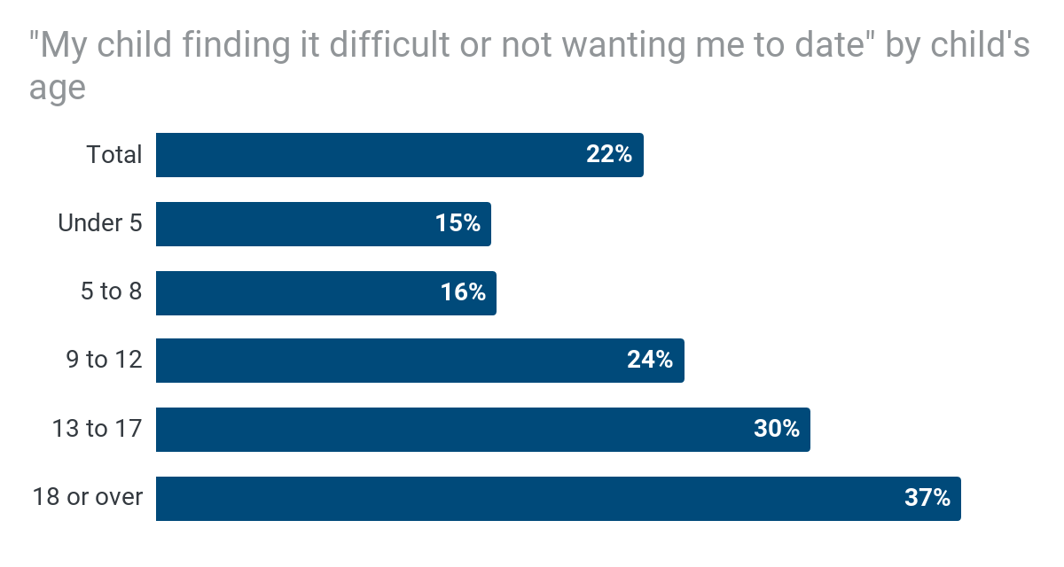
CHILDREN’S IMPACT ON DATING
Around 2 out of 5 (38%) single mums said that they want to wait until their children are older to date so that it’s easier for their children to adapt, and a quarter (23%) said that they want to wait because it could put potential partners off, but this didn’t differ significantly based on the age of respondent’s children.
1 out of 5 (22%) say that they have experienced their child finding it difficult or not wanting them to date. This was significantly more likely for those with older children, reported by 30% of those with a child aged 13 to 17 and 37% of those with an adult child.
Q: Thinking about dating and relationships, to what extent do you agree or disagree with each of the following statements?; Q: Which, if any, of the following have you experienced when dating as a single parent?

Slide 17

DATING DURING COVID

Slide 18
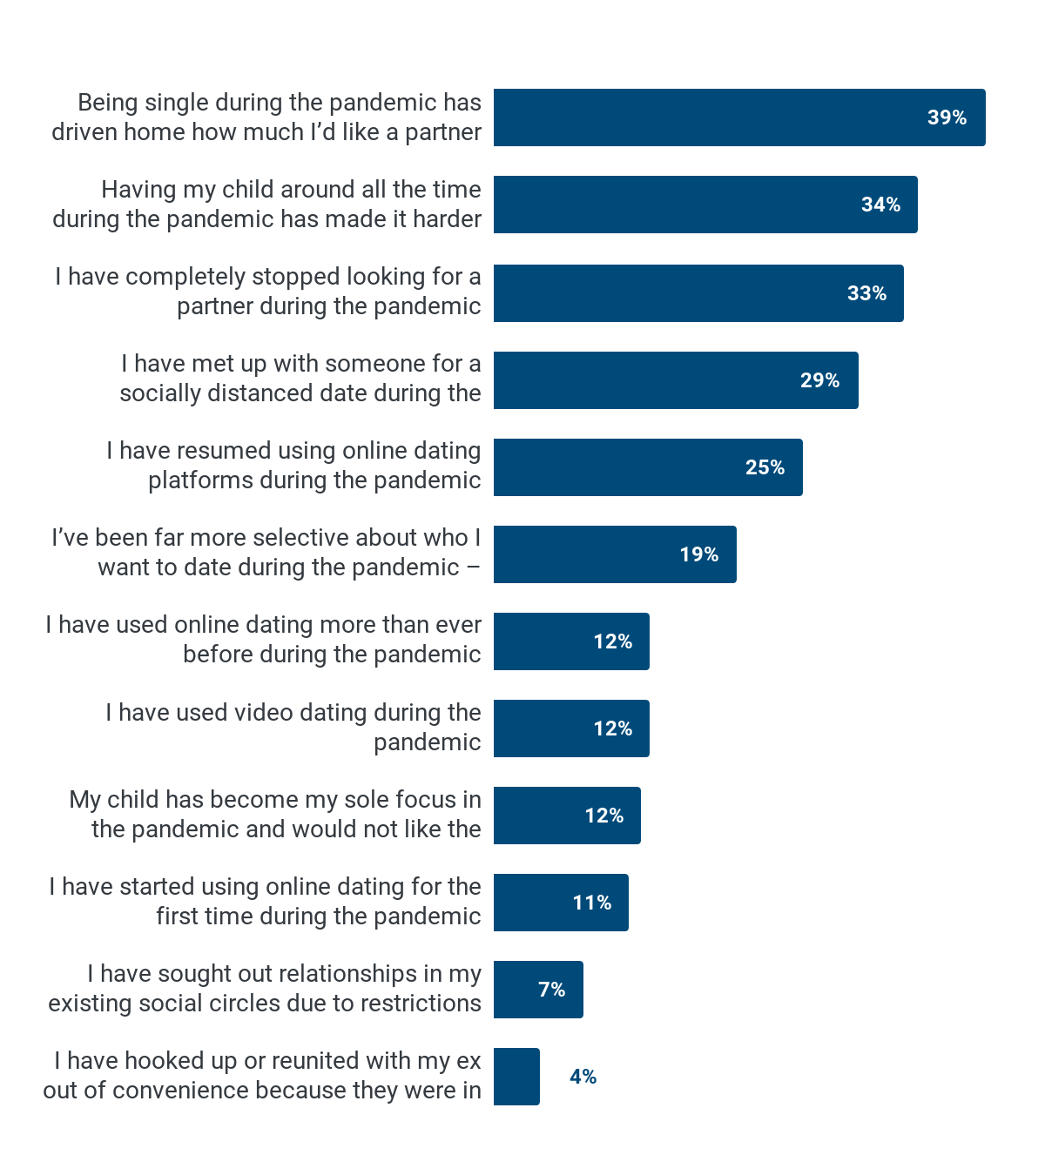
EXPERIENCES OF DATING DURING COVID
Mums reported mixed approaches to dating during the pandemic, with 38% saying that they have used online dating (whether for the first time or continued) during the pandemic, while 33% completely stopped looking for a partner during the pandemic.
Almost 2 in 5 (39%) said that being single during the pandemic has driven home how much they would like a partner, but a third (34%) say that having their child around all the time has made it more difficult to seek out a new relationship.
I think that it was possibly easier to do dates over zoom as a single parent who is totally on my own than if I had to do face to face dates.
Q: Thinking about the Covid-19 pandemic, which (if any) of the following statements apply to you? Please select all that apply

Slide 19

ONLINE DATING

Slide 20
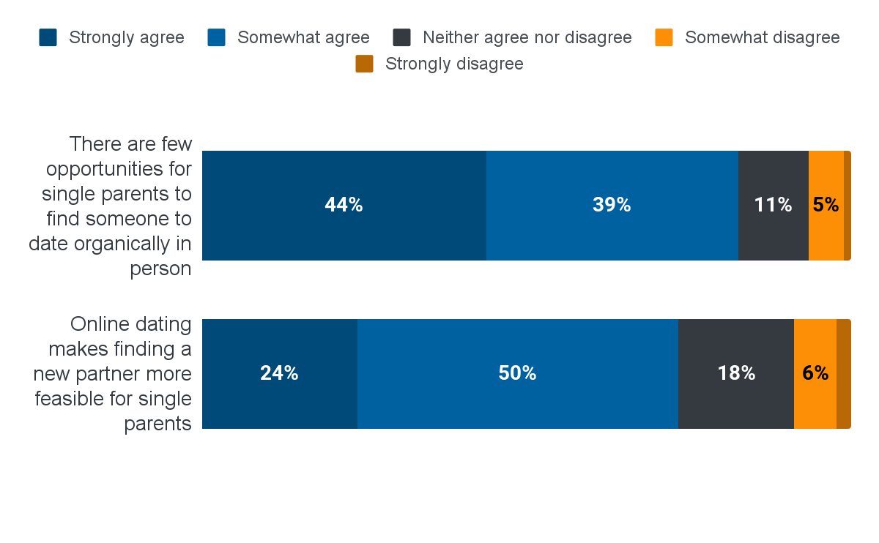
HOW TO DATE AS A SINGLE PARENT
Respondents tended to agree that there are few opportunities for single parents to find someone to date organically (83%), and that online dating makes finding a new partner more feasible for single parents (73%).
However, those with sole custody of their children were significantly less likely to agree that online dating could have this effect (68% vs 80% of those with joint custody).
Q: Thinking about dating for single parents generally, to what extent do you agree or disagree with the following statements?

Slide 21
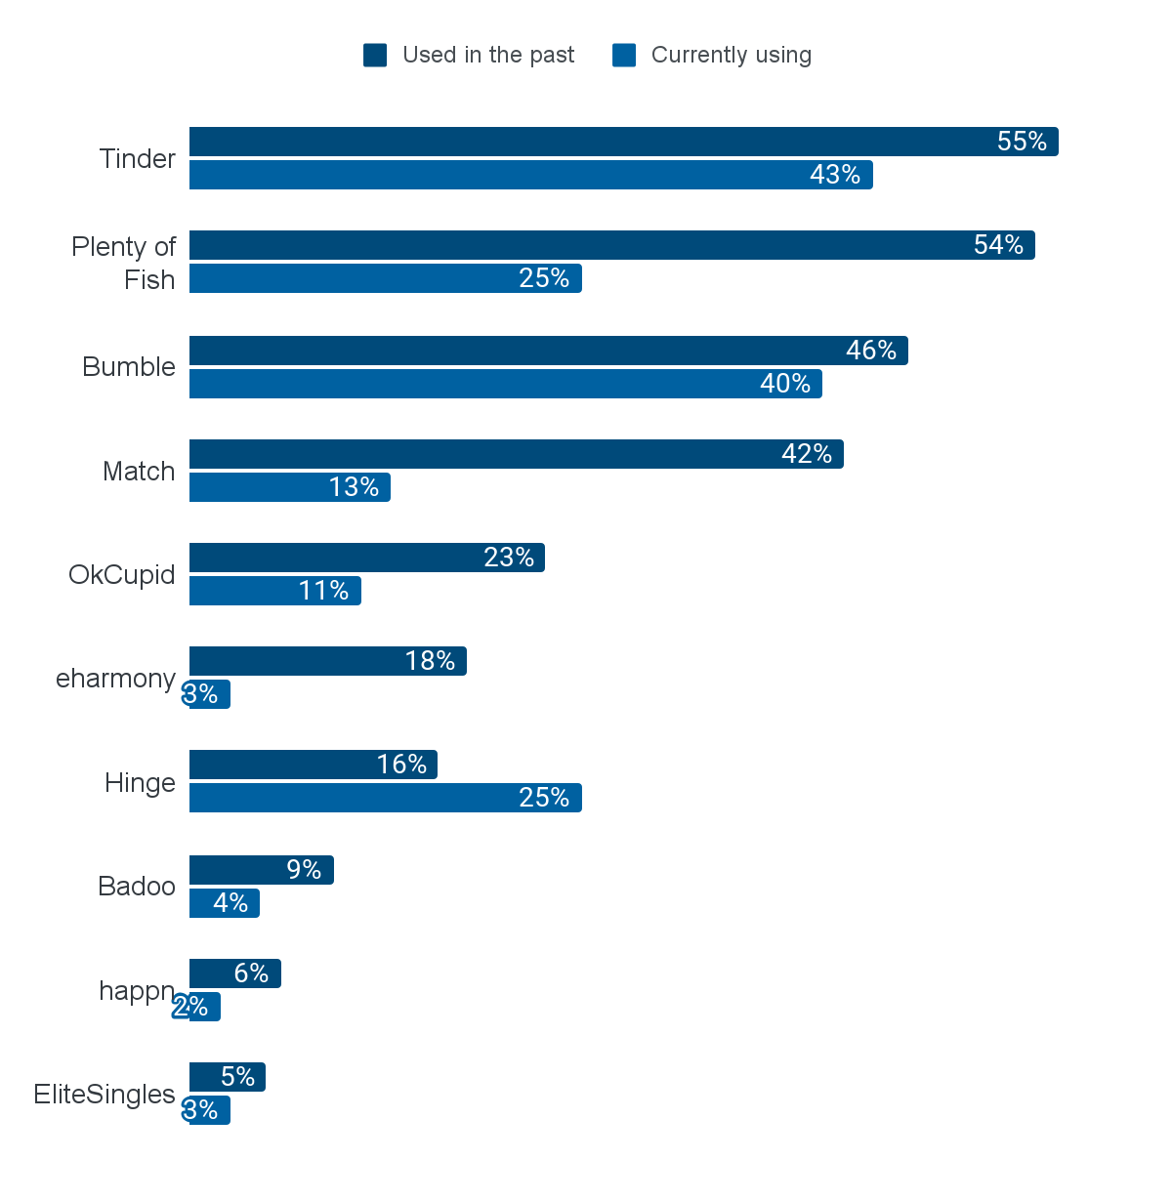
PREFERRED ONLINE DATING PLATFORMS
Tinder, Bumble and Plenty of Fish are the most commonly used online dating platforms for users.
Hinge is the only platform that is being used by a larger proportion of single mums now than in the past, perhaps suggesting its increasing popularity.
Q: Which, if any, of the following online dating platforms do you currently use? Please select all that apply.; Q: Which, if any, of the following online dating platforms have you used in the past? Please select all that apply. Chart showing data where current or previous use is > 5%

Slide 22
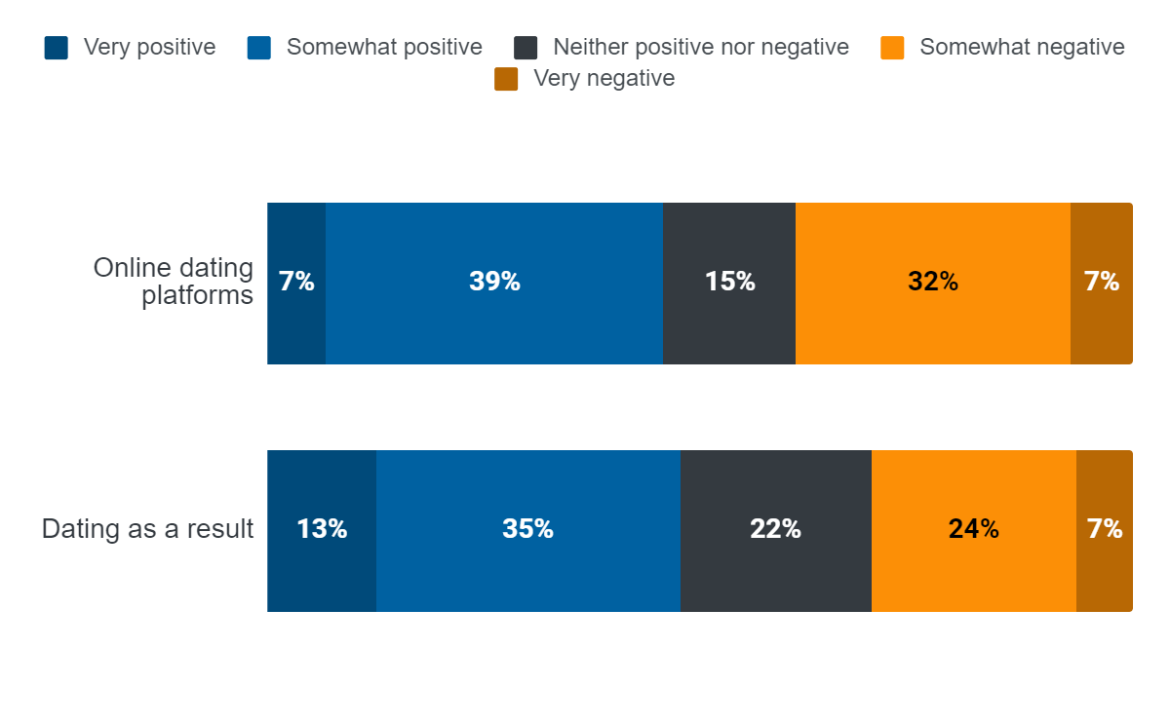
EXPERIENCES OF ONLINE DATING PLATFORMS
Experiences with online dating platforms and dating as a result of them are mixed. 46% say they have had a positive experience with online dating platforms, while 38% say that their experience was negative.
Mums were slightly more likely to report a positive experience of dating as a result of online platforms, with 47% saying their experience has been positive and 30% indicating that theirs was negative.
Q: Generally speaking, how would you categorise your experiences with...

Slide 23
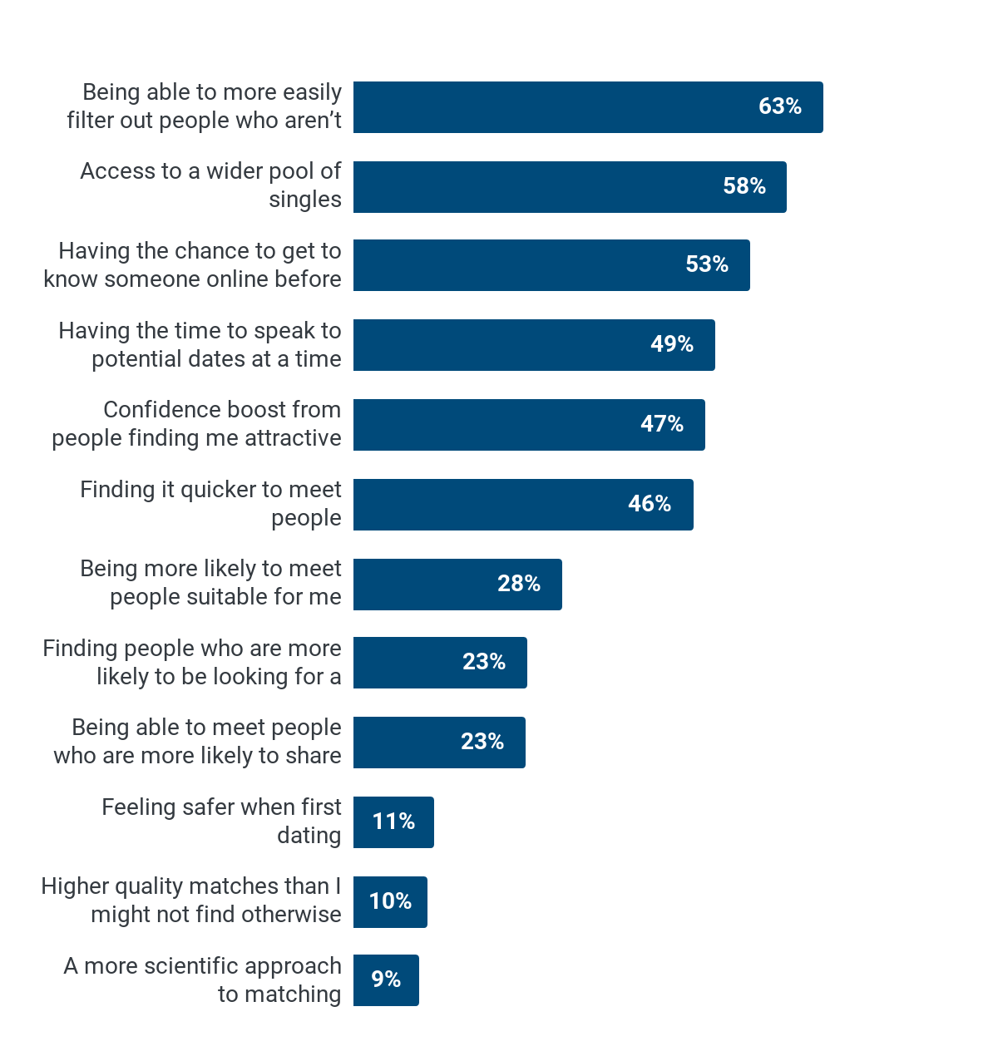
BENEFITS OF ONLINE DATING PLATFORMS
Benefits of online dating platforms recognised by single mums tended to represent being more able to find an appropriate and desirable partner. Half (49%) say that they appreciate having the time to speak to potential dates at a time convenient to them.
Q: Which, if any, of the following have you experienced when using an online dating platform, and would consider a positive? Please select all that apply

Slide 24
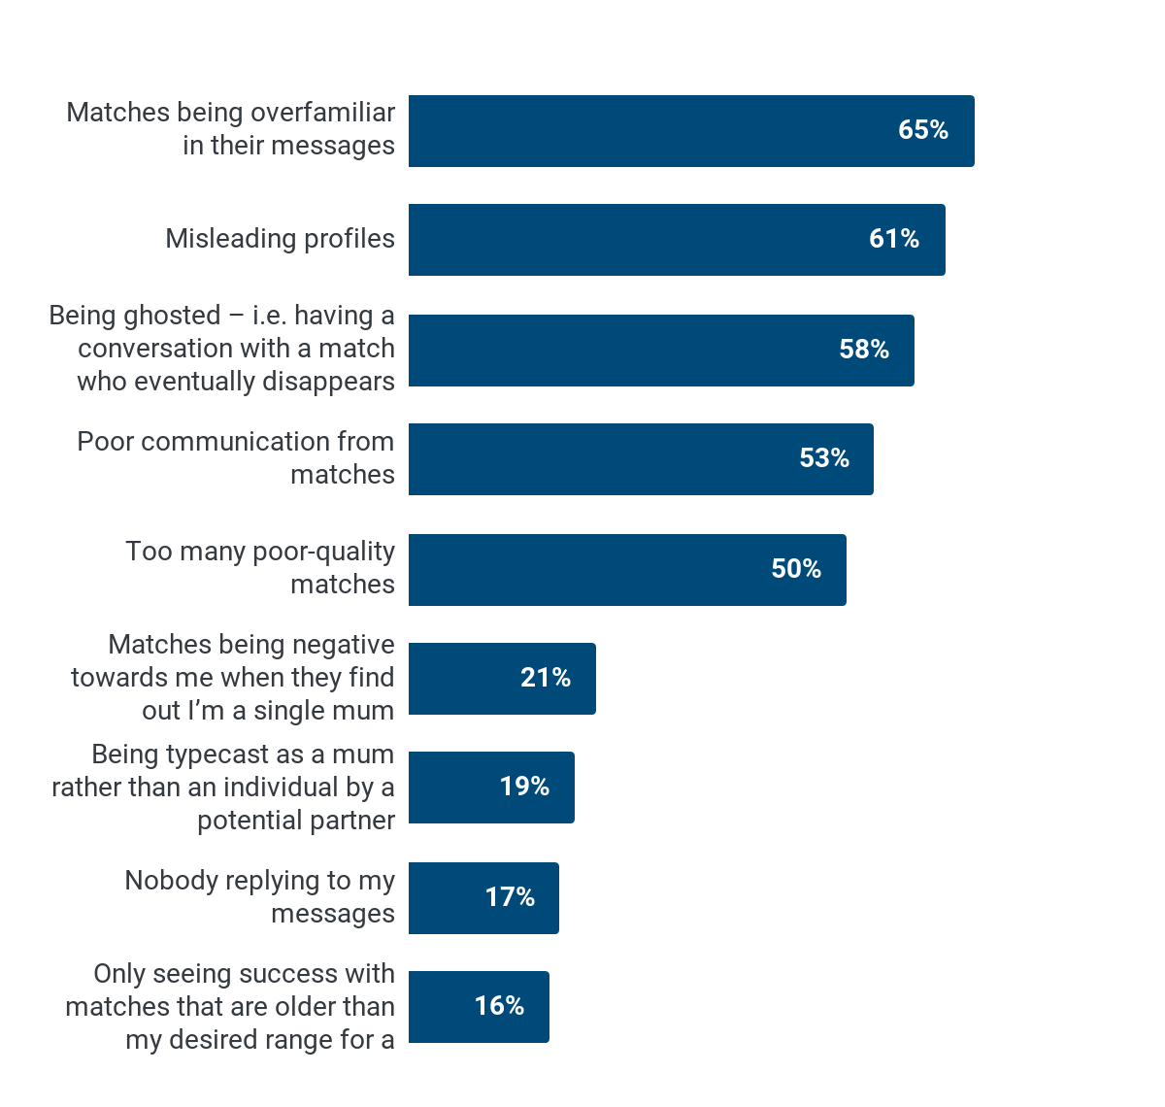
ISSUES WITH ONLINE DATING PLATFORMS
The most common issues with dating apps - mentioned by over half of those who had used them - were matches being over familiar in their messages (65%), misleading profiles (61%), being ghosted (58%), poor communication (53%) and poor quality matches (50%), with issues related to being a mum less prominent for most respondents.
Q: Which, if any, of the following issues have you encountered when using online dating platforms? Please select all that apply.

Slide 25
RECAP
The main obstacle to dating as a single mother is not having enough time to do so (87%)
Many say that their ex partner found a new long term relationship before they did. Equal representation in speed of finding a new long term relationship only seen among those with 50:50 custody or child arrangements.
Most single mothers are upfront about having children in the early stages of dating, with 9 out of 10 mentioning that they have children within a week. However, many wait before talking about their children with new partners, and most are cautious about introducing their children and new partner, with between 6 and 12 months being the preferred time frame.
Single mums believe that single mothers have a harder time when dating than single fathers (87%), with over two thirds (67%) saying that they feel them being a single mother has put potential partners off in the past.
There’s a belief that online dating opens doors for single parents, with three quarters saying that online dating makes dating as a single parent more feasible. However, those with sole custody of their children are significantly less likely to agree, which may be because of the increased time pressures they face.
Negativity on dating apps as a result of being a single mother was more frequently reported by those aged under 35, with 36% of those in this age group indicating that they have been typecast as a single mum rather than an individual and 40% experiencing negativity when potential partners discover that they are a single mum.

